Slide 1





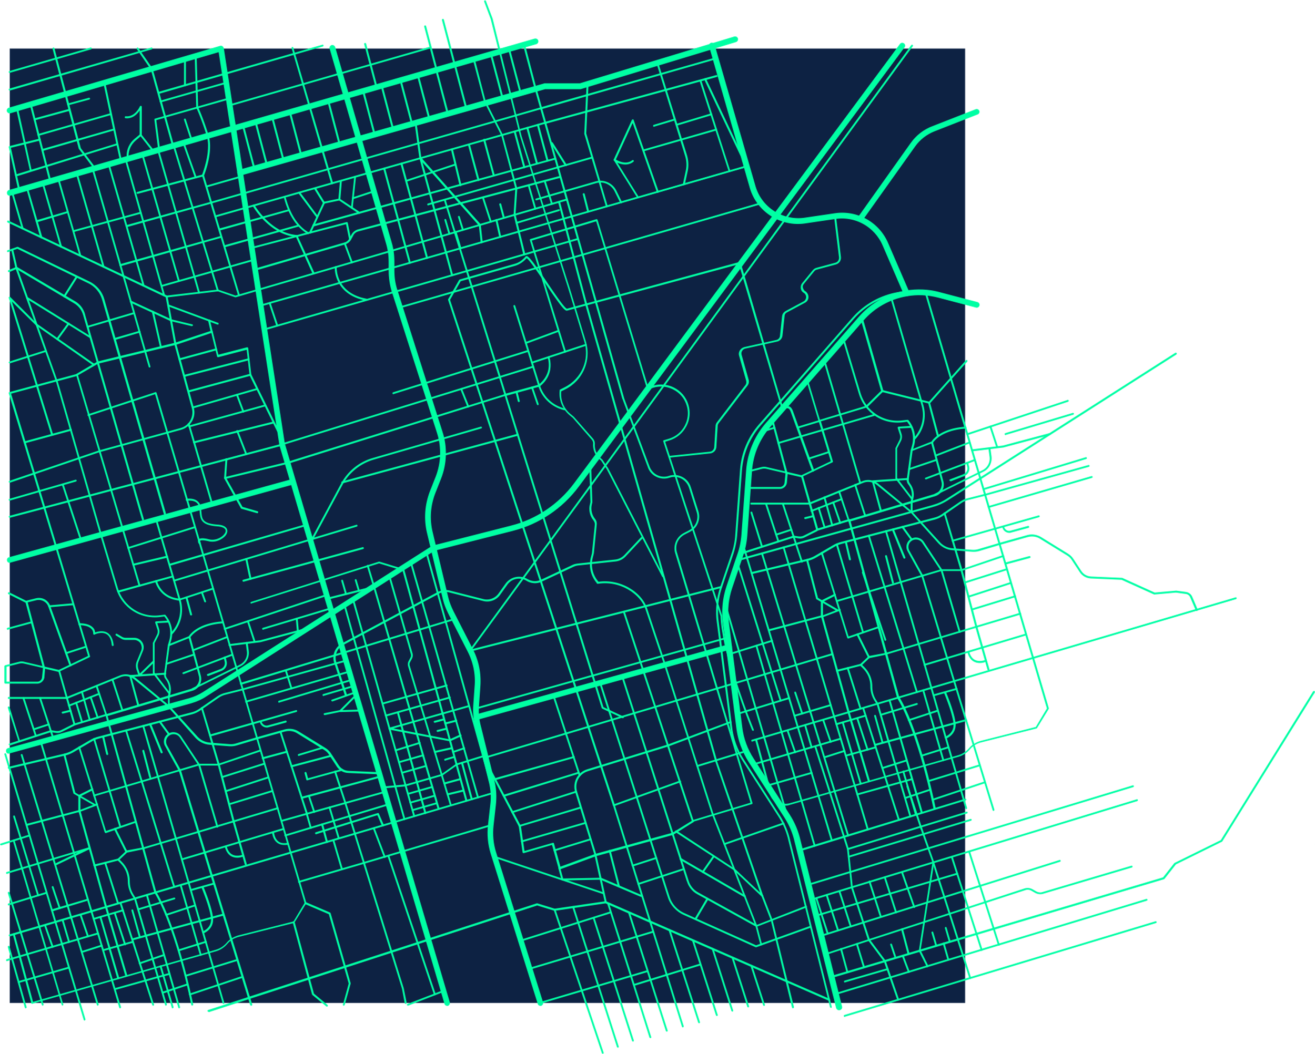
CIS 4560-02
Group 5
Chicago Crime Data Analysis
By: Isabella Jimenez, Jasmine Carvalho, Karla Salazar, Sherman Liang

Slide 2
Introduction
Dataset: Chicago Crimes 2001–Present (City of Chicago Data Portal)
Includes: Reported crimes from 2001–today — date, district, community area, location, and type
Goal: Identify crime trends and patterns across time and location
Focus: Crimes by year, district, time, and type
Tools: Hadoop, Hive, Excel, and Power BI

Slide 3
Data Specifications
Data Set: Crimes_2001_to_Present_2025 | Size: 2.2 GB
Chicago_locations_2001_2012 | Size: 908.4 MB
Chicago_locations_2013_2025 | Size: 592.6 MB
Chicago_summary_by_year_type | Size: 19 KB
Chicago_daily_hourly_trends | Size: 2 KB

Slide 4
Cluster Specifications
OCPU’s | 6
Memory | ~16 GB per node
Storage | 80-100 GB per node
CPU speed | 2.45 GHz
CPU Model Name | AMD EPYC 7763 64-Core Processor

Slide 5
Hadoop Specifications
Hadoop Cluster Version | Hadoop 2.7.1.3.4.2.0-258
Hive version | Hive 1.2.1000.2.4.2.0-258
Number of nodes | 5
HDFS capacity | 390.2 GB total

Slide 6




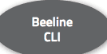





Architecture Chart
Upload
Download
Notes:
Use the Waze presentation & these pictures as examples on how to make the Architecture Chart.

Slide 7
Implementation Flow Chart
Download dataset from City of Chicago Data Portal
2. Upload dataset to HDFS
3. Create external tables in HiveQL
6. Visualize data using Excel and Power BI
5. Export results to CSV
4. Create summary tables for analysis

Slide 8
Implementation of Analysis
Step 1: Downloaded the Chicago Crimes 2001–Present dataset from the City of Chicago Data Portal. Step 2: Uploaded the CSV files to the Hadoop cluster (via HDFS). Step 3: Created external Hive tables (chicago_raw, chicago_cleaned, and chicago_final) to store and manage data. Step 4: Defined HiveQL schemas specifying key fields such as date, district, community area, latitude, longitude, and crime type.

Slide 9
Implementation of Analysis(Cont’d)
Step 5: Cleaned data in Hive by removing null values, standardizing date formats, and selecting important columns. Step 6: Created summary tables to group data by year, district, time, and crime type. Step 7: Exported summary results to CSV for visualization. Step 8: Built visualizations using Excel 3D Maps and Power BI dashboards to show spatial and time-based crime trends.

Slide 10
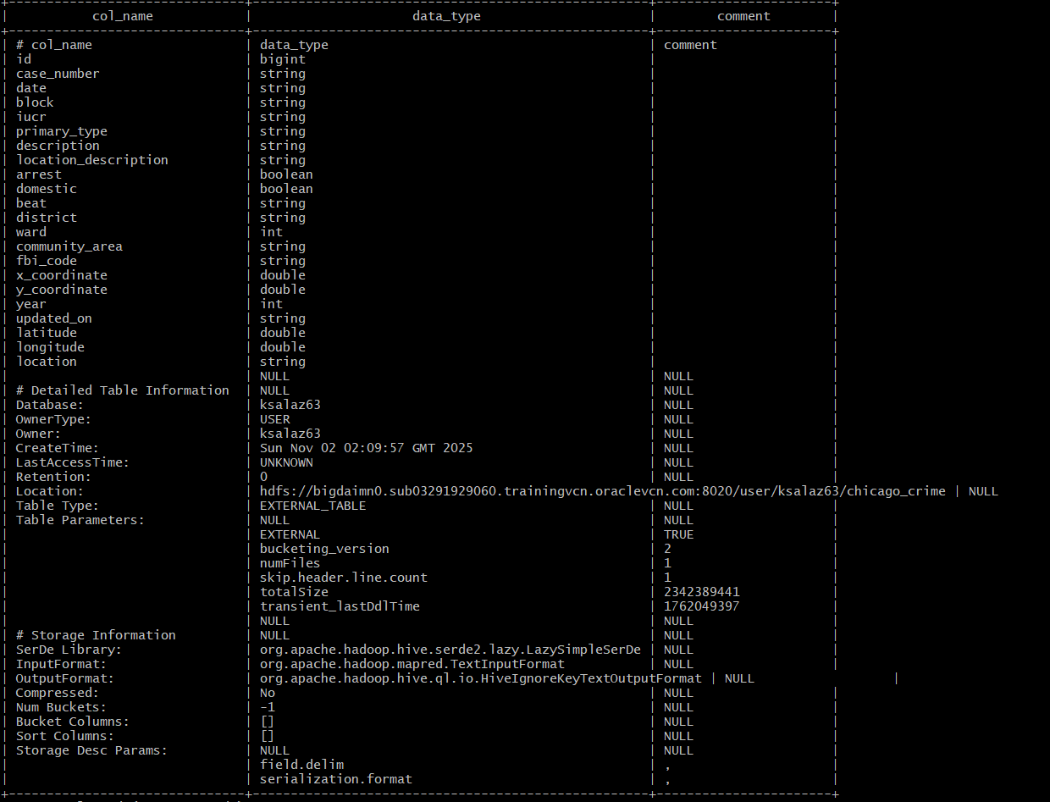
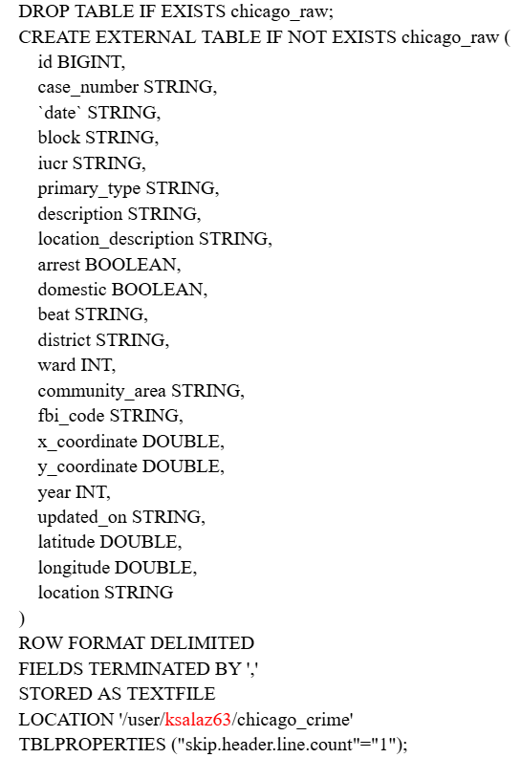
1st External Table:
chicago_raw

Slide 11
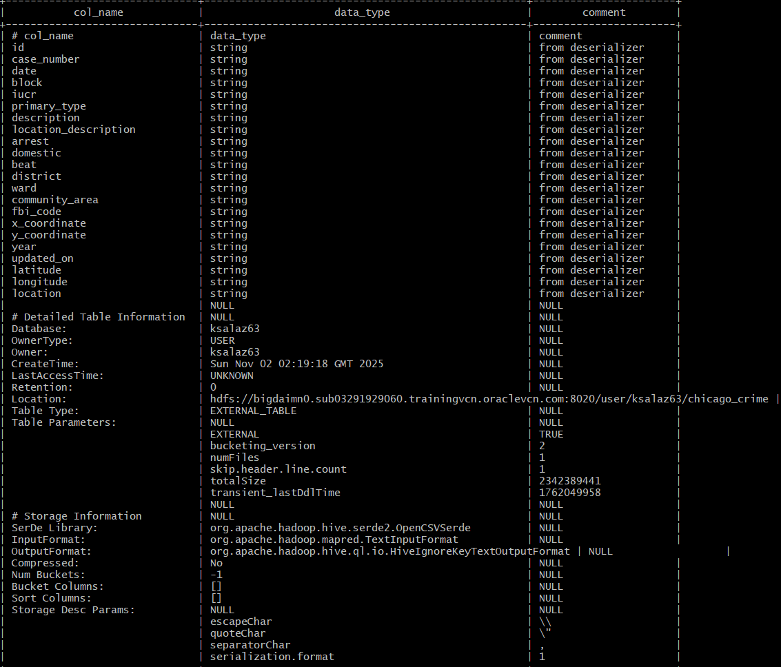
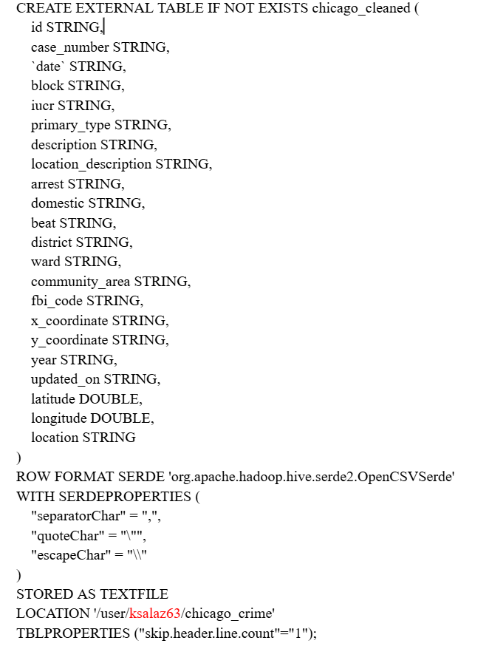
2nd External Table:
chicago_cleaned

Slide 12
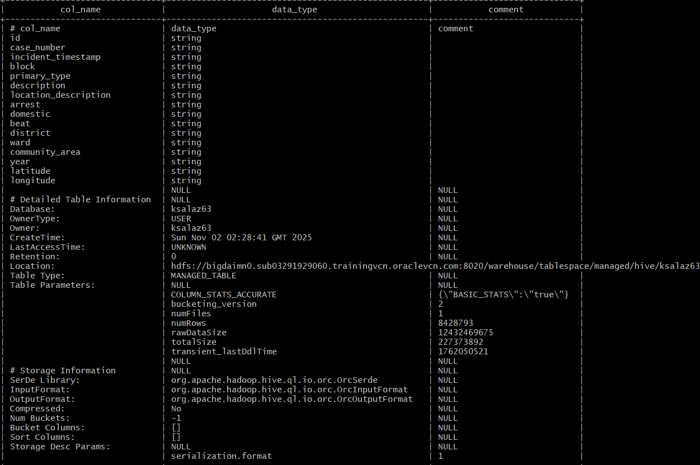
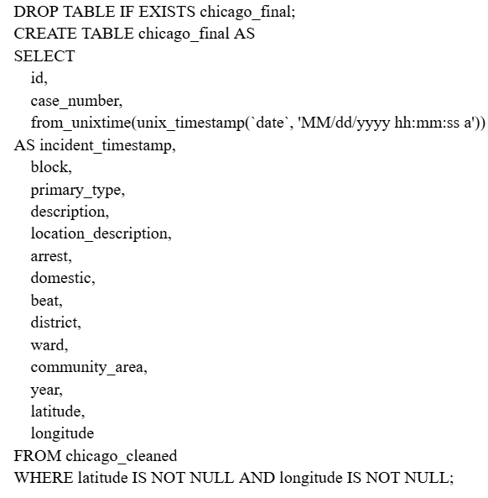
3nd External Table:
chicago_final

Slide 13
Visualization
Information we are using:
Time/Date (Year, Hour, Day of Week)
X and Y coordinates (Longitude & Latitude)
District
Crime type (Sum/Count)
Tools we are using:
Excel - 3D map
Power BI - Bar, Line, and Pie Chart

Slide 14




3D Map: Timeline (2010-2012)

Slide 15
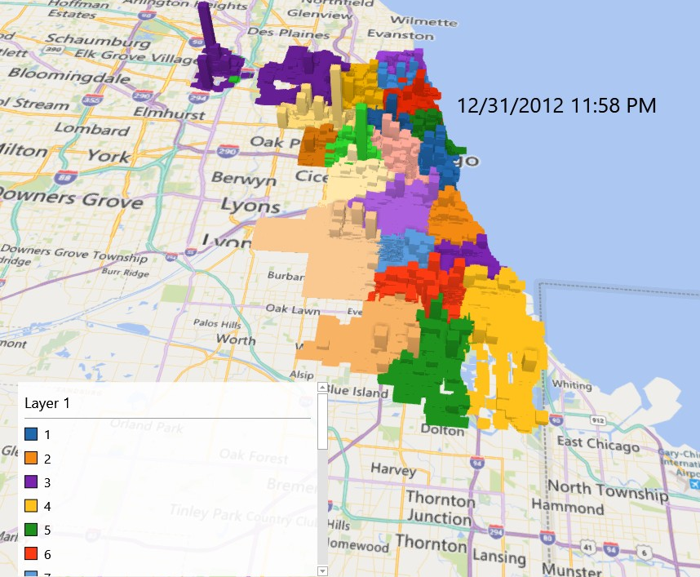
Map of Crime Frequency by District
2010-2012
Key Findings
Highest activity — South and West Side districts (7, 8, 9, 10, 11, 15, 25) consistently show the tallest spikes, driven by battery, robbery, narcotics, and weapon-related crimes.
Moderate activity — Downtown and Near North (1, 18) maintain steady mid-level bars, mostly property crimes such as theft and pickpocketing.
Lowest activity) — North and Northwest districts (16, 17, 19, 20, 24) show small, stable bars, indicating lower crime and non-violent incidents.

Slide 16
3D Map: Timeline (2021-2025)

Slide 17
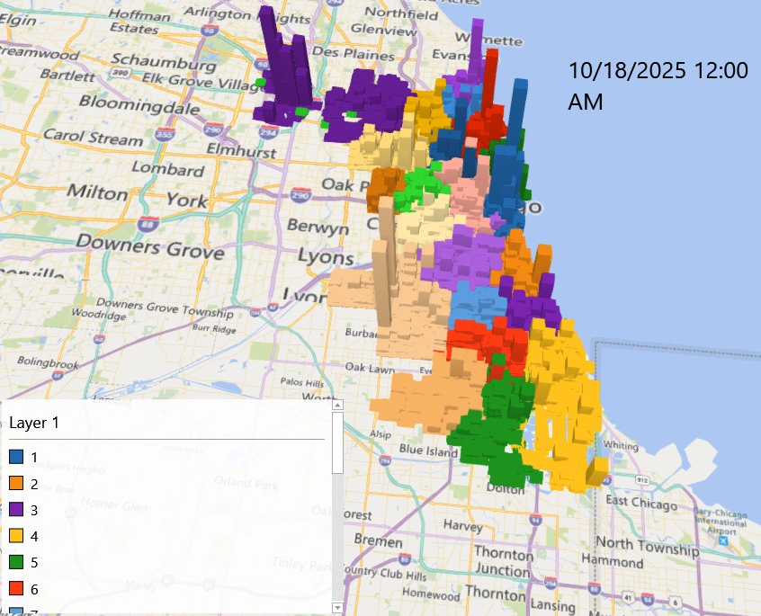
Map of Crime Frequency by District
2021-2025
Key Findings
Heavily concentrated— Remains in South and West Side districts (7, 8, 9, 10, 11, 15, 25), with District 11 and 7 showing the largest and most persistent spikes.
Activity increase— Downtown and Near North districts (1, 12, 18) reflecting increasing theft, robbery, and vehicle crime compared to earlier years.
Emerging changes— Vehicle theft surges, created new moderate hotspots in several North and Northwest districts (16, 17, 19).

Slide 18
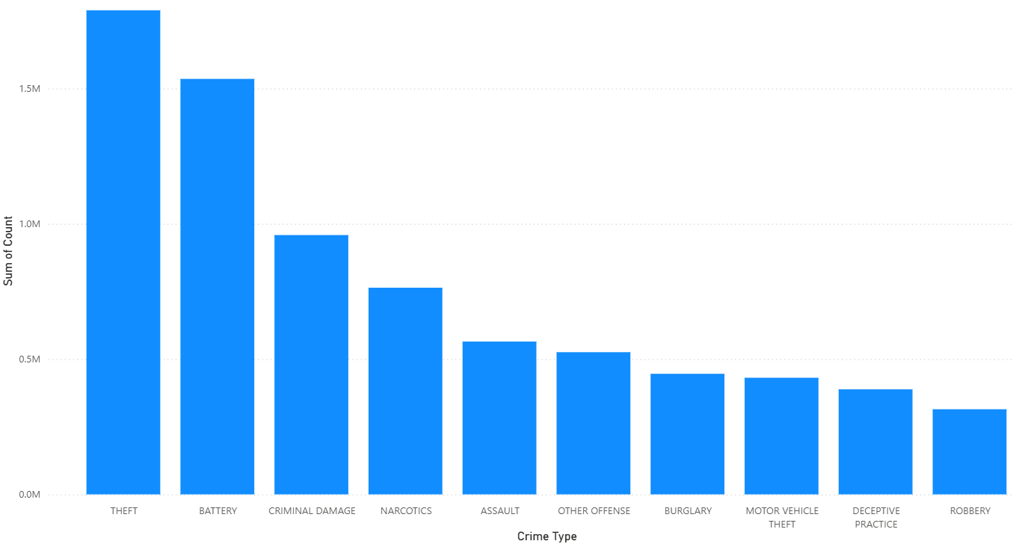
Sum of Count By Crime Type

Slide 19

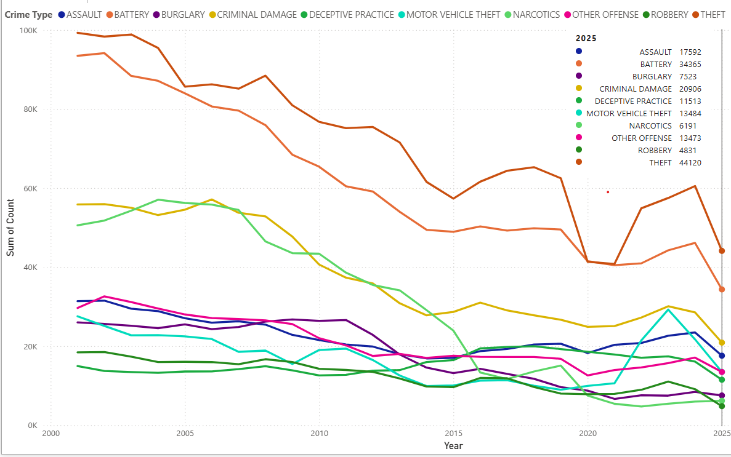
Trends of Top 10 Chicago Crime Types
Key Findings
Long-Term Trend: Overall crime in Chicago is trending downwards over the years.
Top Crimes: Theft, Battery, and Criminal Damage remain the top three most frequent crime types for over two decades.
Narcotics cases started high, but plummeted since the early 2000s.
Downward Trend: Lower-volume offenses (including Assault, Motor Vehicle Theft, Burglary, and Robbery)
Recent Spike: Despite the downward trend, all top ten crime categories have seen a spike or increase in the 2020s

Slide 20
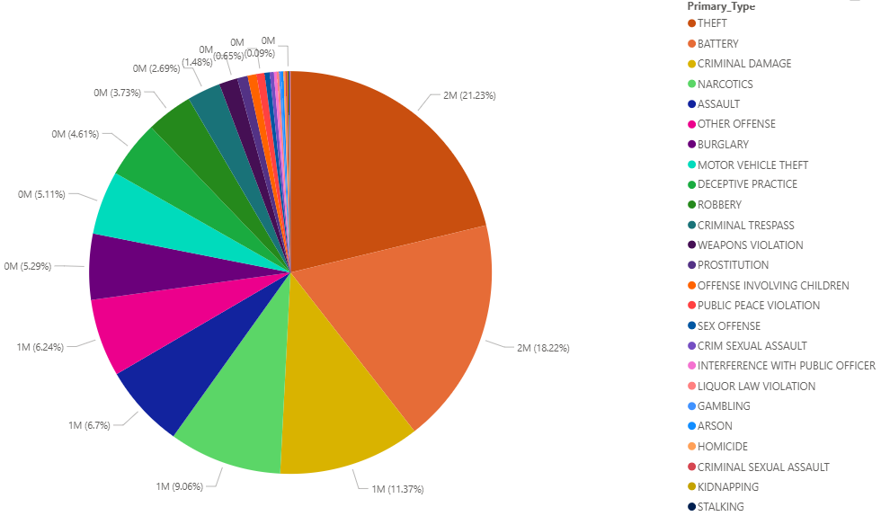
Crime Distribution by Type
Key Findings
Dominant Offense: Theft is the most frequently reported crime,with a percentage of 21.23%.
Top 3 Concentration: Theft (21.23%), Battery (18.22%), and Criminal Damage (11.37%)—together account for ~50% of the total crime volume.
Violent Crime Share: Assault (6.7%) and Robbery (3.73%), make up a smaller proportion of the total volume compared to property and damage crimes.
Minority Offenses: A large number of crime categories, particularly serious felonies like Homicide, Kidnapping, and Stalking, individually represent less than 1% of the total reported incidents.

Slide 21
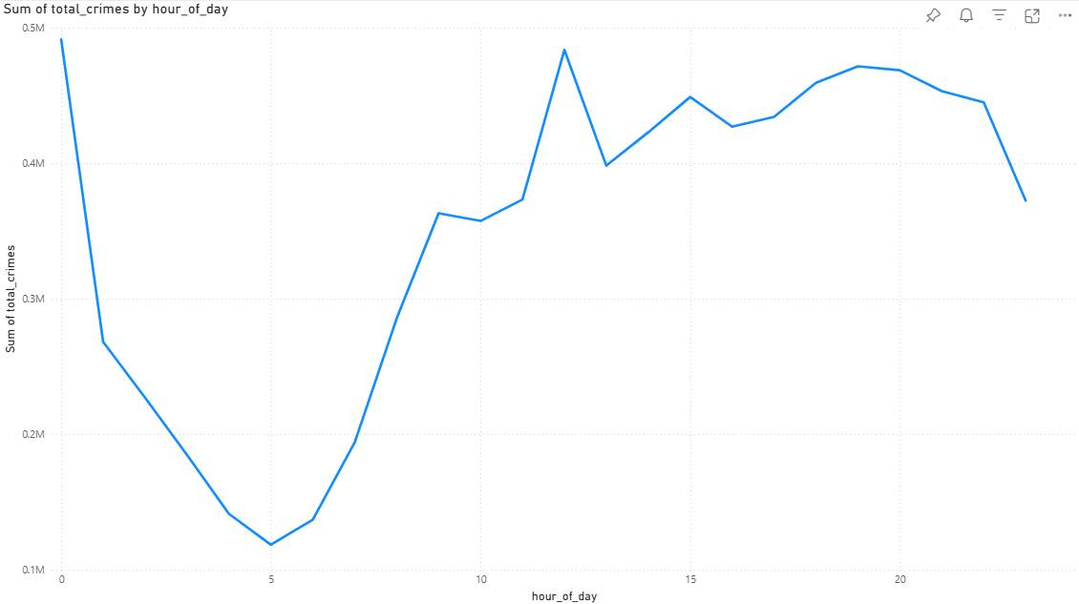
24-Hour Crime Pattern
Key Findings
Peak Crime Window (The Surge): The highest volume of crime occurs during the afternoon and early evening.
Morning Rush: A distinct, but lower, peak in incidents is observed around 9:00 AM, likely coinciding with the start of the typical workday and increased outdoor activity.
Safest Hours (The Trough): The lowest period for crime activity is the early morning, specifically between 4:00 AM and 5:00 AM.
Sustained Daytime Risk: Crime levels remain relatively high and steady throughout the entire workday before the evening spike begins

Slide 22
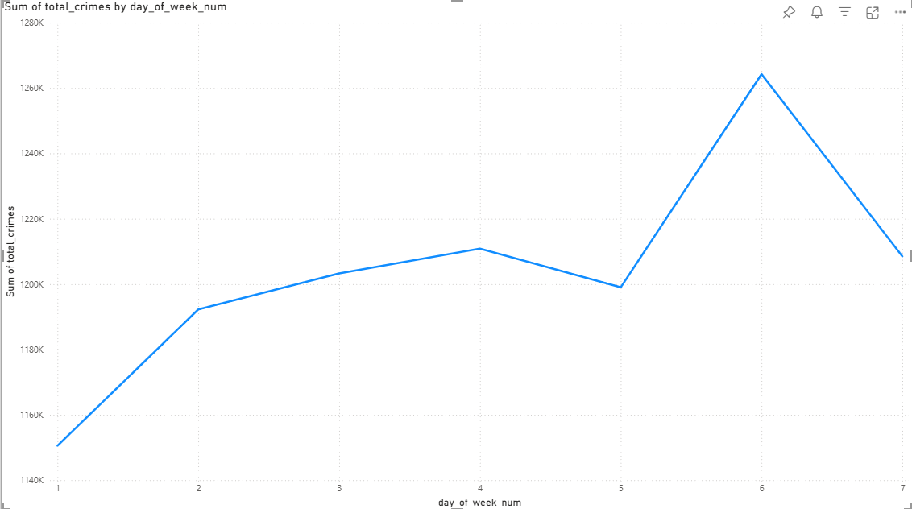
Total Crime Count by Day of Week
Key Findings
Peak Day: Friday (D6) experiences the highest volume of crime throughout the week, showing a significant surge compared to all other days.
Lowest Day: Sunday shows the lowest overall crime count (lowest point)
The Weekend Effect: Crime volume peaks at the start of the weekend (Friday) and sees a notable drop on Saturday.
Mid-Week Consistency: Crime levels remain relatively high and stable across the main weekdays (M-Th).

Slide 23
Conclusion
Property Crimes Dominate: Non-violent offenses, primarily Theft, Battery, and Criminal Damage, account for nearly 50% of all reported incidents in the dataset.
Predictable High-Risk Times: Crime is highly time-dependent, peaking during periods of high public activity.
The highest risk occurs on Fridays and during the afternoon/early evening rush hour.
The lowest crime activity is reliably recorded on Sunday and in the predawn hours (4:00 AM–5:00 AM).
Spatial Focus & Recent Surge: Risk remains concentrated in South and West Side districts. Despite historical declines, all major crime categories have experienced a concerning spike since the 2020s, demanding new attention.

Slide 24

GitHub Link
https://github.com/ksalaz63/ChicagoCrime2001-2025
Tutorial
Presentation
Codes
Report

Slide 25


